Slide 1

Advanced Topics in Economic Evaluation and Healthcare
Lecture #2: Searching the Literature, Measuring Costs, Measuring Effects

Slide 2
Lecture Overview
In this lecture we will discuss.
  What literature cost effectiveness studies are built out from.
  The Measurement and Determination of Costs.
  The Measurement and Determination of Effects (QALYs, DALYs and other Outcomes).
By the end of this lecture you will know how to leverage requisite data sources for critiquing and conducting cost effectiveness analysis.

Slide 3
Searching the Literature

Slide 4
Review: Economic Evaluation and The Life Cycle of a Drug
Price
Clinical Trials Phase I
Registration
Pharmacology
Phase II
Drug surveillance
Chronical toxicity
Acute Toxicology
Phase III
Patent filed
Discovery
Patent Expires
Time
Research
10 years
Administration
20 years
15 years

Slide 5
Review: Economic Evaluation and The Life Cycle of a Drug
Price
Clinical Trials Phase I
Registration
Pharmacology
Phase II
Drug surveillance
Chronical toxicity
Acute Toxicology
Phase III
Patent filed
Discovery
Patent Expires
Time
Research
10 years
Administration
20 years
15 years
Cost Effectiveness Research is Situated Adjacent to Clinical Research.
While not everyone can do medical research– in principle anyone can discuss, debate
and argue its value

Slide 6

REVIEW: A “Model Free” Approach to Cost Effectiveness Analysis
$$λ^{A}=\frac{ΔC_{A}}{ΔE_{A}}=\frac{C_{A}−C_{B}}{E_{A}−E_{B}}$$
Costs of A
Effects of A
Treatment A
(The Alternative)
Treatment B
Baseline
Treatment
Costs of B
Effects of B

Slide 7
REVIEW: A “Model Free” Approach to Cost Effectiveness Analysis
$$λ^{A}=\frac{ΔC_{A}}{ΔE_{A}}=\frac{C_{A}−C_{B}}{E_{A}−E_{B}}$$
Costs of A
Effects of A
Treatment A
(The Alternative)
While missing some details, this structure is
nearly identical to that of a randomized controlled trial!
Treatment B
Baseline
Treatment
Costs of B
Effects of B

Slide 8
The Challenge: Reading Medical Literature as a Non-Clinician– What we are looking for.
On an outset, what is being asked of everyone of us as analysts is to do something you may not be comfortable with– Review published medical literature– specifically results from clinical trials.
What we are looking for is as follows:
  What is the medical intervention being evaluated?
  Who is the patient population?
  What is the novel treatment and what is the control treatment?
  Where in the clinical pathway is a treatment being used?
  What are the possible health states of patients?
Formally this is related to PICO Framework.
  Patient Population: The patient group, disease, or health issue under study.
  Intervention: The specific treatment, test, or action being evaluated.
  Comparison: The standard care or control being used for comparison.
  Outcome: The measurable effect that is expected to be seen.

Slide 9
Where to find literature
There are several databases for finding trial data. Some of these are:
  ClinicalTrials.gov
  Pubmed
  WHO International Clinical Trials Registry Platform
Note this is a “primary search” where we would try to conduct a cost effectiveness analysis based on previously conducted cost effectiveness research. We can also search cost effectiveness models directly which answer similar questions to the ones we have.
The number of journals and resources for this is numerous, however often you will find cost effectiveness studies in medical journals directly.
  This is because questions of cost effectiveness concern practitioners directly.

Slide 10
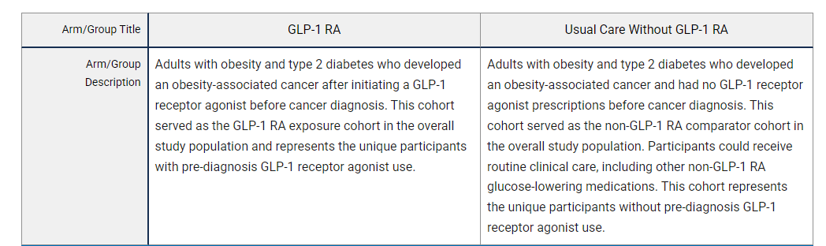
Example: a first cut at a “model free” cost effectiveness analysis
To get an idea of how its possible to use clinical trail data to conduct a cost effectiveness analysis consider the following study on clinicaltrials.gov
Pre-Diagnosis GLP-1 Receptor Agonist Use and Post-Cancer Mortality in Adults With Obesity and Type 2 Diabetes
This study analyzes the effect of GLP-1 use on obesity related cancer survival.

Slide 11
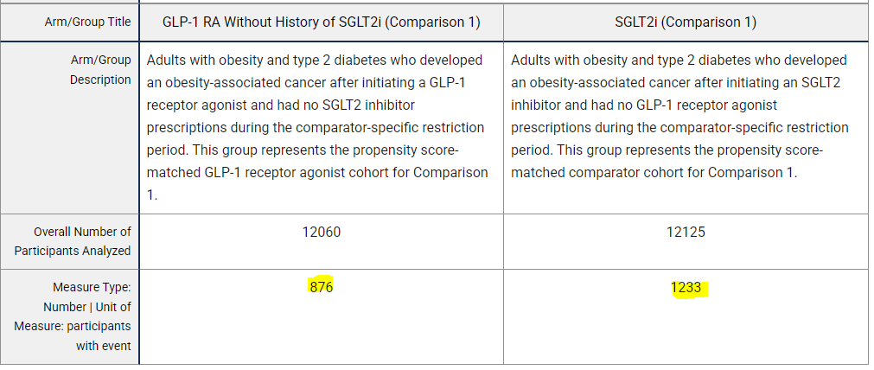
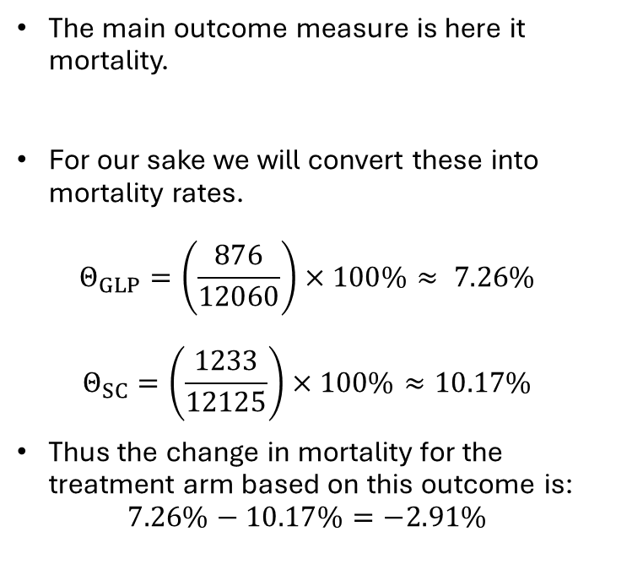
Example: a first cut at a “model free” cost effectiveness analysis
The main outcome measure is here it mortality.
For our sake we will convert these into mortality rates.
$Θ_{GLP}=\left(\frac{876}{12060}\right)×100\%≈ 7.26\%$
$Θ_{SC}=\left(\frac{1233}{12125}\right)×100\%≈10.17\%$
Thus the change in mortality for the treatment arm based on this outcome is:
$7.26\%−10.17\%=−2.91\%$

Slide 12

REVIEW: A “Model Free” Approach to Cost Effectiveness Analysis
Costs of A
Effects of A
Treatment A
(The Alternative)
$$λ^{A}=\frac{ΔC_{A}}{ΔE_{A}}=\frac{C_{A}−C_{B}}{E_{A}−E_{B}}$$
Costs of B
Effects of B
Treatment B
Baseline
Treatment

Slide 13
REVIEW: A “Model Free” Approach to Cost Effectiveness Analysis
Costs?
Mortality Rate= -7.26%
GLP-1 Assisted
Treatment
$$λ^{A}=\frac{ΔC_{A}}{ΔE_{A}}=\frac{C_{A}−C_{B}}{E_{A}−E_{B}}$$
Costs?
Mortality Rate=-10.17%
Standard Care

Slide 14
REVIEW: A “Model Free” Approach to Cost Effectiveness Analysis
Costs?
Mortality Rate= -7.26%
GLP-1 Assisted
Treatment
$$λ^{A}=\frac{ΔC_{A}}{ΔE_{A}}=\frac{C_{A}−C_{B}}{E_{A}−E_{B}}$$
Costs?
Mortality Rate=-10.17%
Standard Care

Slide 15
REVIEW: A “Model Free” Approach to Cost Effectiveness Analysis
Costs?
Mortality Rate= -7.26%
GLP-1 Assisted
Treatment
$$λ^{A}=\frac{ΔC_{A}}{ΔE_{A}}=\frac{C_{A}−C_{B}}{E_{A}−E_{B}}$$
Costs?
Mortality Rate=-10.17%
Standard Care

Slide 16
What is holding us back in our “Model Free” Cost effectiveness analysis
We are missing data on costs.
Therefore we cant compute the ICER [or more specifically in the case of when reduction mortality is used as denominator– The value of a statistical life (VSL)] to define the value of this treatment!
This “missing data problem” will motivate the slides ahead.
Some questions to think about are:
  Where do we find data on costs of treatment?
  What if we don’t care about mortality but rather quality of life? How is that valued and where is this data found?
  What if a treatment is utilized in a broader clinical pathway?

Slide 17
What is holding us back in our “Model Free” Cost effectiveness analysis
We are missing data on costs.
Therefore we cant compute the ICER [or more specifically in the case of when reduction mortality is used as denominator– The value of a statistical life (VSL)] to define the value of this treatment!
This “missing data problem” will motivate the slides ahead.
Some questions to think about are:
  Where do we find data on costs of treatment? (ANSWERED TODAY!)
  What if we don’t care about mortality but rather quality of life? How is that valued and where is this data found? (ANSWERED TODAY!)
  What if a treatment is utilized in a broader clinical pathway? (ANSWERED IN FUTURE CLASSES!)

Slide 18
Data on Costs

Slide 19
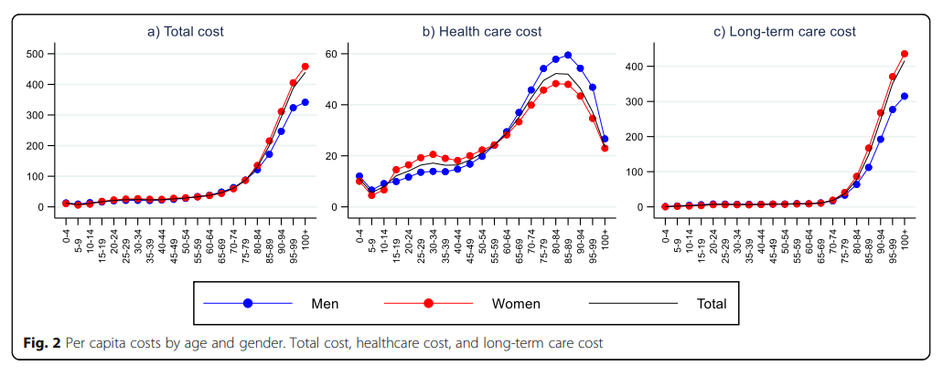
Facts about Costs over the lifecycle
*This figure presents per capita health expenditure for health expenditures in Norway. The shape of these curves are generalizable across the life cycle.
Kalseth, J., & Halvorsen, T. (2020). Health and care service utilisation and cost over the life-span: a descriptive analysis of population data. BMC health services research, 20(1), 435.

Slide 20
Some Data Sources on Costs
There are a multitude of data sources which you can use for identifying costs. Ideally, if you have exact dollar amounts for each treatment provided based on provider knowledge this is the best.
More often than not, the independent researcher will find themselves making estimates.
Some tools for “micro-costing” which we will discuss today are:
  The CIHI Patient Cost Estimator
  Ontario’s Interactive Drug Formulary Search
A more comprehensive list of costing resources are provided by the Canadian Drug Authority’s list of publicly available canadian cost information.
NOTE: By the very nature and complexity of costs and the dependence on the healthcare environment this overview of tools is incomplete.

Slide 21
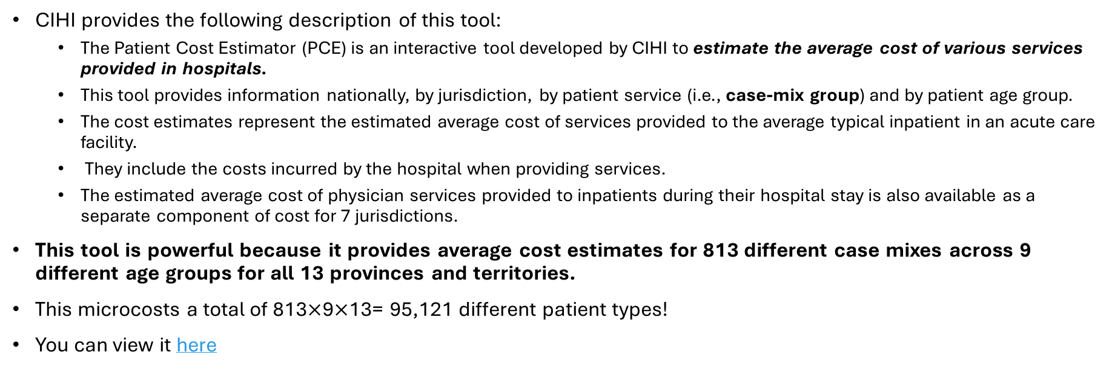
The CIHI Patient Cost Calculator
CIHI provides the following description of this tool:
  The Patient Cost Estimator (PCE) is an interactive tool developed by CIHI to estimate the average cost of various services provided in hospitals.
  This tool provides information nationally, by jurisdiction, by patient service (i.e., case-mix group) and by patient age group.
  The cost estimates represent the estimated average cost of services provided to the average typical inpatient in an acute care facility.
  They include the costs incurred by the hospital when providing services.
  The estimated average cost of physician services provided to inpatients during their hospital stay is also available as a separate component of cost for 7 jurisdictions.
This tool is powerful because it provides average cost estimates for 813 different case mixes across 9 different age groups for all 13 provinces and territories.
This microcosts a total of 813$×$9$×$13= 95,121 different patient types!
You can view it here

Slide 22
The CIHI Patient Cost Calculator
Some things to consider when using this
This data set provides estimates of average costs at the hospital level.
  It does not consider different costs or sequencing along a patient’s treatment plan or provide estimates of the variation in costs which may occur.
  Further, as this is based on case mix, some patient groups may be aggregated together.
  Treatment which occurs outside of a hospital environment are often not included in this database.
BOTTOM LINE: The CIHI Patient Cost Calculator is a Powerful Tool. However if you are looking for more granularity in your costing approach you may need a different set of data.

Slide 23
Ontario’s Drug Formulary Search
The Ontario drug formulary search tool is a tool which provides a detailed costing for the approved drugs and treatments in Ontario.
The use of this tool is to provide exact estimates for microcosting specific approved drugs. It also helps provide a sense of what the cost of these treatments are.
To relate the search back to the example cost effectiveness analysis (or in our context since VSL is computed it is a cost benefit analysis) we will search for generic names of the GLP-1s
The search term we care about are SEMAGLUTIDE.

Slide 24
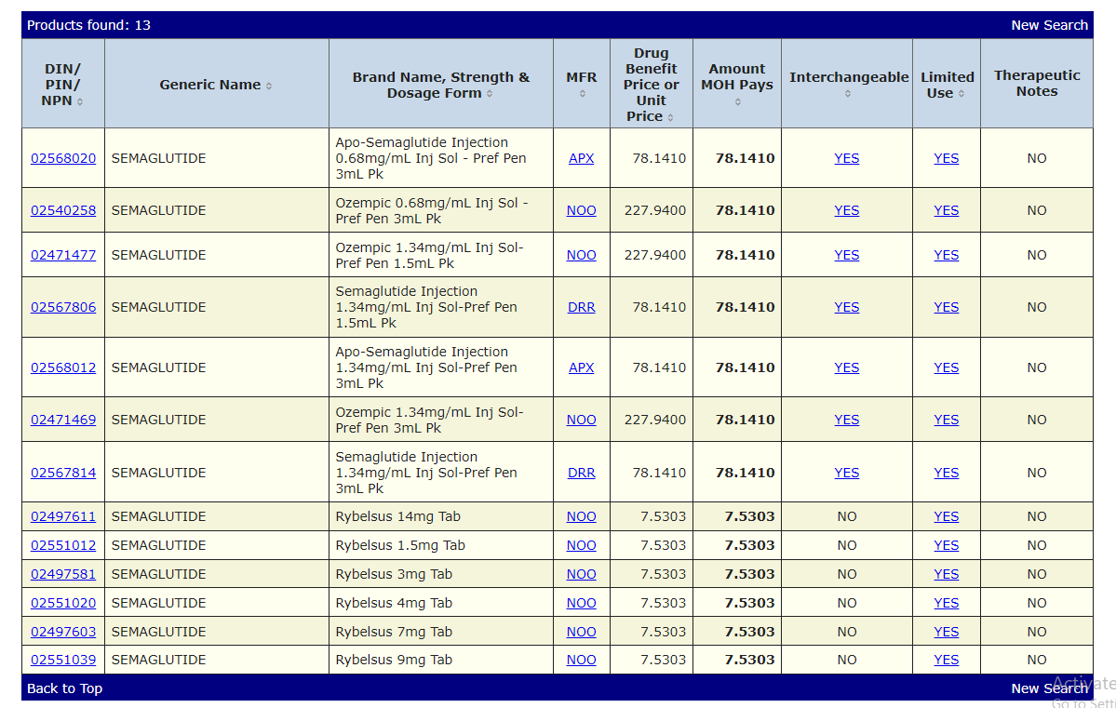
Ontario’s Drug Formulary Search

Slide 25
Ontario’s Drug Formulary Search
Average Cost= $142.34

Slide 26
Revising the Cost Effectiveness Analysis
Costs?
Mortality Rate= -7.26%
GLP-1 Assisted
Treatment
$$λ^{A}=\frac{ΔC_{A}}{ΔE_{A}}=\frac{C_{A}−C_{B}}{E_{A}−E_{B}}$$
Costs?
Mortality Rate=-10.17%
Standard Care

Slide 27
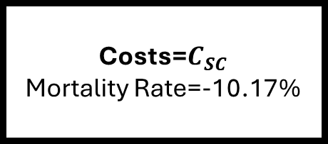
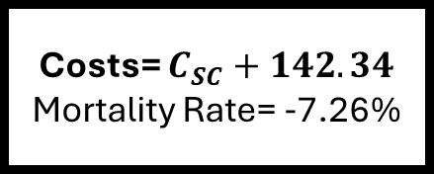
Revising the Cost Effectiveness Analysis
Costs= $C_{SC}+142.34$
Mortality Rate= -7.26%
Costs on each arm are symmetric with
some unmeasured standard care component.
GLP-1 Assisted
Treatment
$$λ^{A}=\frac{ΔC_{A}}{ΔE_{A}}=\frac{C_{A}−C_{B}}{E_{A}−E_{B}}$$
Costs=$C_{SC}$
Mortality Rate=-10.17%
Standard Care

Slide 28
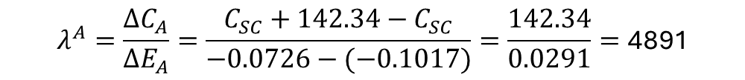
Revising the Cost Effectiveness Analysis
Costs= $C_{SC}+142.34$
Mortality Rate= -7.26%
Costs on each arm are symmetric with
some unmeasured standard care component.
GLP-1 Assisted
Treatment
$$λ^{A}=\frac{ΔC_{A}}{ΔE_{A}}=\frac{C_{SC}+142.34−C_{SC}}{−0.0726−(−0.1017)}=\frac{142.34}{0.0291}=\text{4891}$$
Costs=$C_{SC}$
Mortality Rate=-10.17%
Standard Care

Slide 29
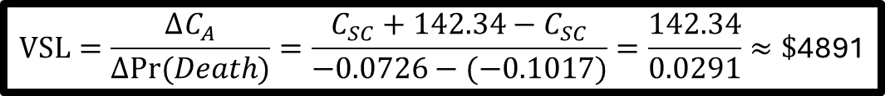
Revising the Cost Effectiveness Analysis
Costs= $C_{SC}+142.34$
Mortality Rate= -7.26%
GLP-1 Assisted
Treatment
$$VSL=\frac{ΔC_{A}}{ΔPr⁡(Death)}=\frac{C_{SC}+142.34−C_{SC}}{−0.0726−(−0.1017)}=\frac{142.34}{0.0291}≈\text{\$}\text{4891}$$
Costs=$C_{SC}$
Mortality Rate=-10.17%
Since our effects are in changes in mortality,
we are computing the cost for a statistical life
Standard Care

Slide 30
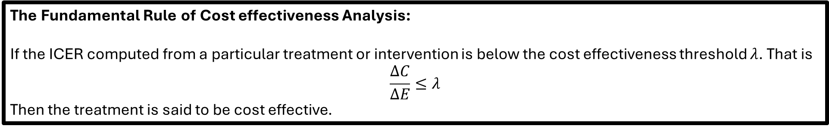
We computed the VSL. Now what?
On our way to explaining cost effectiveness analysis and where to get data on costs and effects, we showed the primary focus of this class– the determination of the value of a treatment.
We did this by producing an estimate of the cost per statistical life (or value for a statistical life).
How do we know if this VSL is “Good or Not?”– The answer: willingness to pay thresholds.
In general if the ICER, VSL or other ratio is below a particular willingness to pay threshold then we would say that there is value for money.
The Fundamental Rule of Cost effectiveness Analysis:
If the ICER computed from a particular treatment or intervention is below the cost effectiveness threshold $λ$. That is
$$\frac{ΔC}{ΔE}≤λ$$
Then the treatment is said to be cost effective.

Slide 31
What is a GOOD VSL?
VSL studies are primarily American and outside the field of health.
  U.S. Department of Transportation (DOT): Uses a central VSL of $14.2 million (evaluated using a 2025 base year) for analyzing the safety benefits of transportation infrastructure and vehicle regulations.
  U.S. Department of Health and Human Services (HHS): Employs a central VSL benchmark of $13.1 million (with sensitivity ranges typically spanning from roughly $6.1 million to $19.9 million depending on the literature and assumptions used).
  U.S. Environmental Protection Agency (EPA): Historically pioneered many of these metrics and uses comparable figures adjusted for base-year dollars (typically aligning closely with the $10M–$14M window depending on the specific regulatory impact analysis guidelines).
In this example the VSL computed is well below each of these. Thus we would declare the use of GLP-1s for post cancer mortality as cost effective (through this cost benefit analysis).

Slide 32
Data on Effects
Clinical Indexes and the QALY

Slide 33
Cost Effectiveness Analysis and Cost Utility Analysis
Recall: This course is about valuing healthcare interventions.\
As such we need data on costs and effects.
Cost benefit analysis (for better or worse) has been relegated to fields outside of health. This is because we care about placing values on health.
This requires measurements of changes in health. We can either value health based on
  Change in clinically relevant indices (Conduct a Cost Effectiveness Analysis)
  Change in quality of life with a more comprehensive Quality Adjusted Life Year (Conduct Cost Utility Analysis CUA).

Slide 34
Clinical Indexes
A word on clinical indexes:
  The use of clinical outcomes is fine for comparisons across interventions in a single patient population.
  However, the study’s contribution to broader decision-making is limited because it only allows for comparisons.
Theres is a tradeoff between cost effectiveness analysis (which uses outcome based indexes) and cost utility analysis (which uses quality of life).
In Clinical Environments
- Analysis with Clinical Indexes may make more sense for resource allocation in a specific division.
In the context of allocating from a global budget
-Analysis with a more universal measure such as the QALY is more appropriate.
We will not be discussing a general theory of constructing medical indexes.
However, we will use them in a context.

Slide 35
The comparability problem in economic evaluation
Economic evaluation is used as a tool for evaluating the cost effectiveness of new drugs or medical interventions.
In the context of cost effectiveness analysis which measures improvement along some medical outcome, the utilization of the computed ICER is impossible to use when comparing other treatments.
i.e. if one treatment is valued in dollars per change in mobility score and another treatment is valued in dollars per change in blood pressure, how do we determine which treatment to fund?
The issue with valuing the cost effectiveness of different interventions is that without a universal measure of health, it is impossible to compare and rank very different treatments.

Slide 36
The Quality Adjusted Life Year
Health Economists solve this issue by using a universal Quality of Life (QoL) index which values the health outcomes in question.
The most popular Quality of Life measurement used in economic evaluation is the Quality Adjusted Life Year (QALY).
The reason why it is powerful is because it values life based on both an individals quality of life at a particular point in time and how long the individual lives in that state.
There is the following saying about QALYs in Economic Evaluation.
“A QALY IS A QALY IS A QALY”
This means that regardless of the treatment in question the QALY has the ability to make very different treatments comparable through their index.

Slide 37
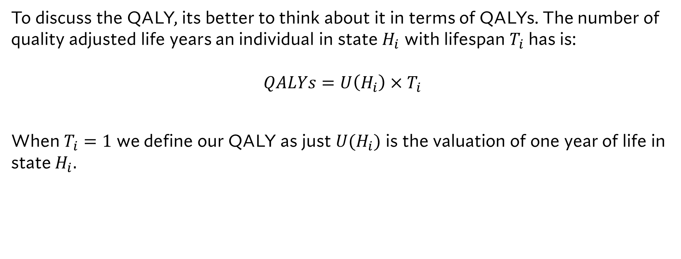
Technical Properties of the QALY
To discuss the QALY, its better to think about it in terms of QALYs. The number of quality adjusted life years an individual in state $H_{i}$ with lifespan $T_{i}$ has is:
$QALYs=U\left(H_{i}\right)×T_{i}$
When $T_{i}=1$ we define our QALY as just $U(H_{i})$ is the valuation of one year of life in state $H_{i}.$

Slide 38
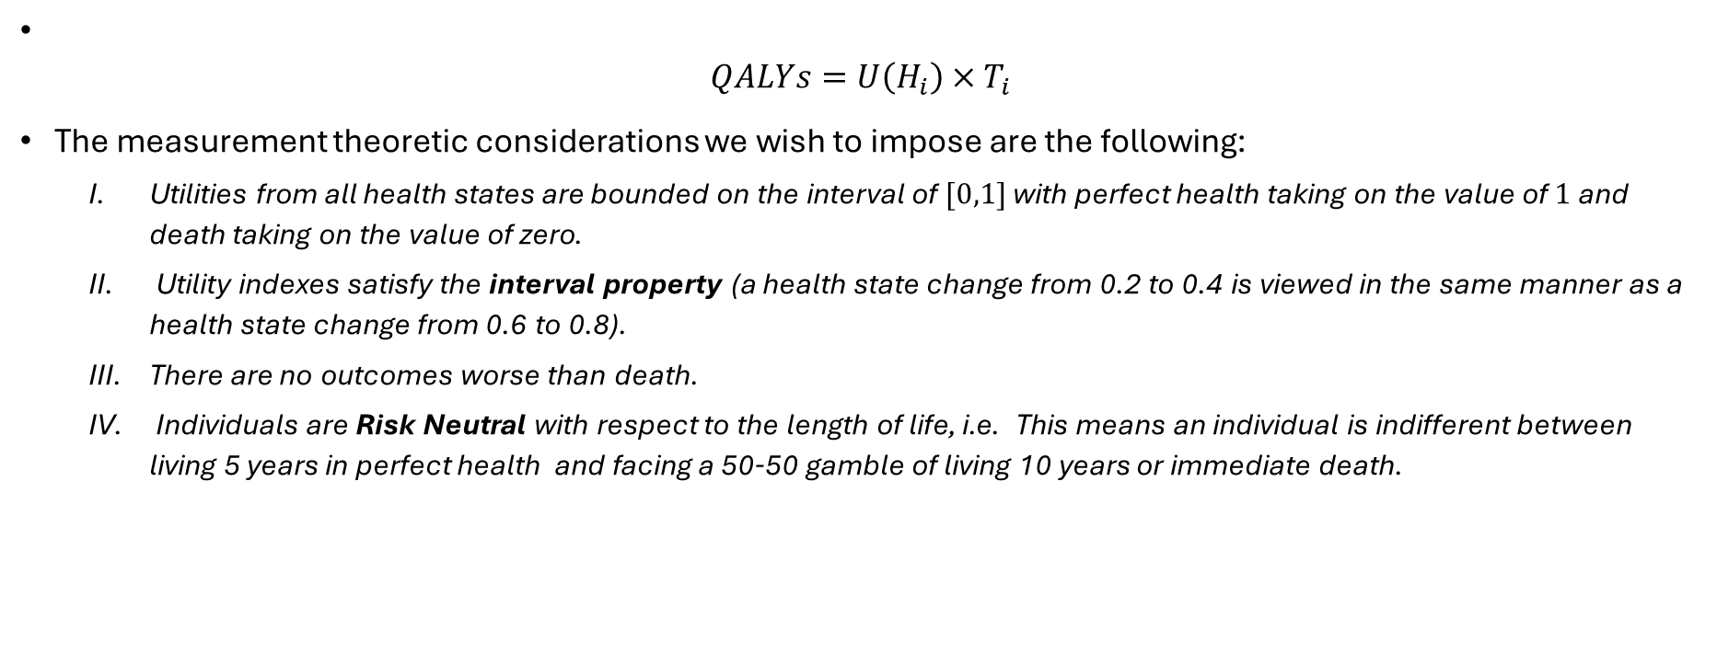
Technical Properties of the QALY
$QALYs=U\left(H_{i}\right)×T_{i}$
The measurement theoretic considerations we wish to impose are the following:
  Utilities from all health states are bounded on the interval of $[0,1]$with perfect health taking on the value of $1$ and death taking on the value of zero.
  Utility indexes satisfy the interval property (a health state change from 0.2 to 0.4 is viewed in the same manner as a health state change from 0.6 to 0.8).
  There are no outcomes worse than death.
  Individuals are Risk Neutral with respect to the length of life, i.e. This means an individual is indifferent between living 5 years in perfect health and facing a 50-50 gamble of living 10 years or immediate death.

Slide 39
How Utilities are Measured

Slide 40
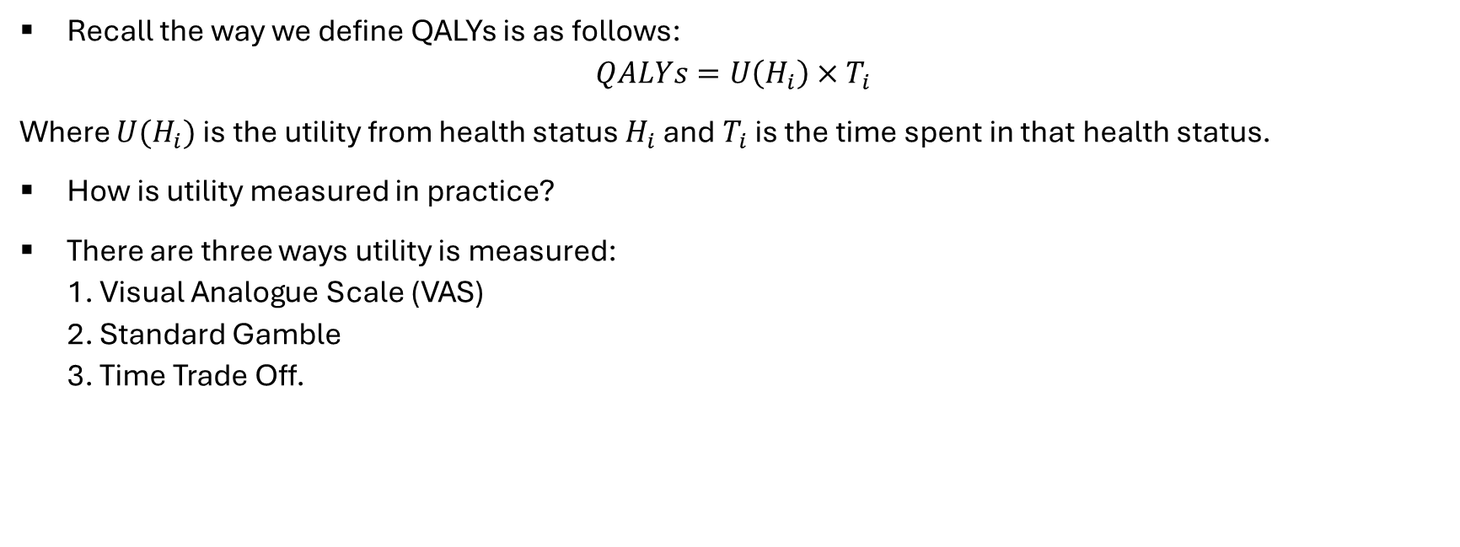
Utility Measurement
Recall the way we define QALYs is as follows:
$$QALYs=U\left(H_{i}\right)×T_{i}$$
Where $U(H_{i})$ is the utility from health status $H_{i}$ and $T_{i}$ is the time spent in that health status.
How is utility measured in practice?
There are three ways utility is measured:
1. Visual Analogue Scale (VAS)
2. Standard Gamble
3. Time Trade Off.

Slide 41
Visual Analogue Scale
To employ the use of the Visual Analogue Scale, patients are simply shown a feeling thermometer and asked how to rank their quality of life.
This method is crude, but it explicitly satisfies the measurement theoretic properties required of QALYs.
Alternatively, this valuation can involve a series of questions and score on a rubric.
0
Worst Imaginable
Health State
100
Perfect Health
*To satisfy our measurement properties, we renormalize any score to be on the [0,1] interval

Slide 42
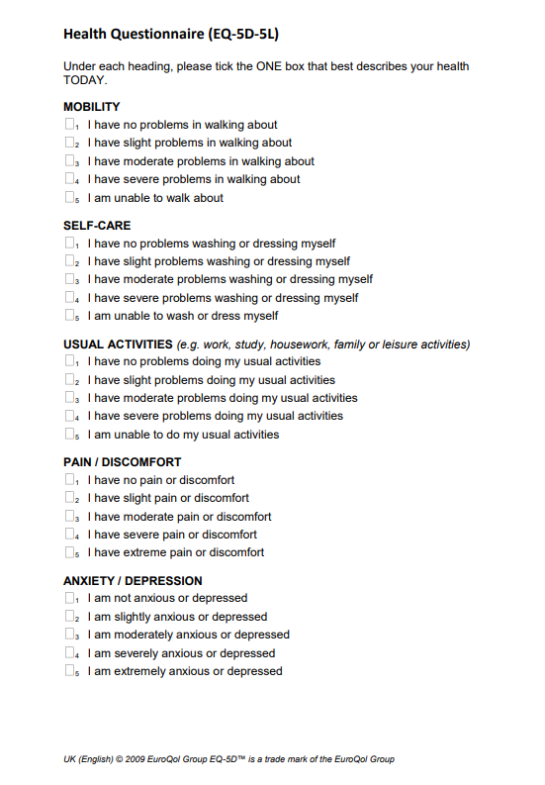
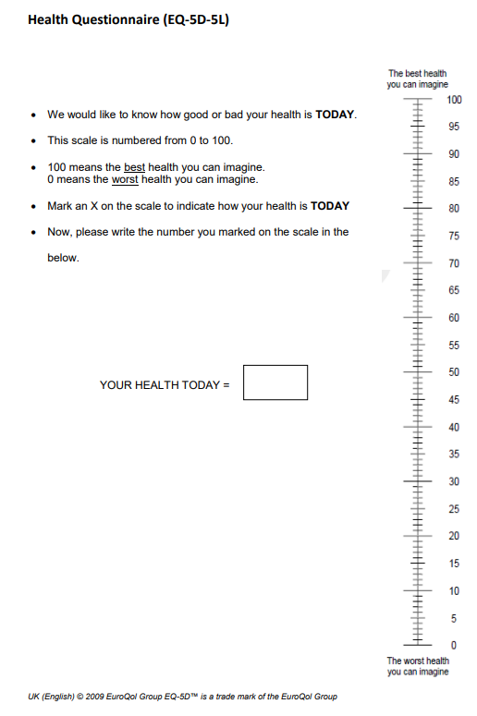
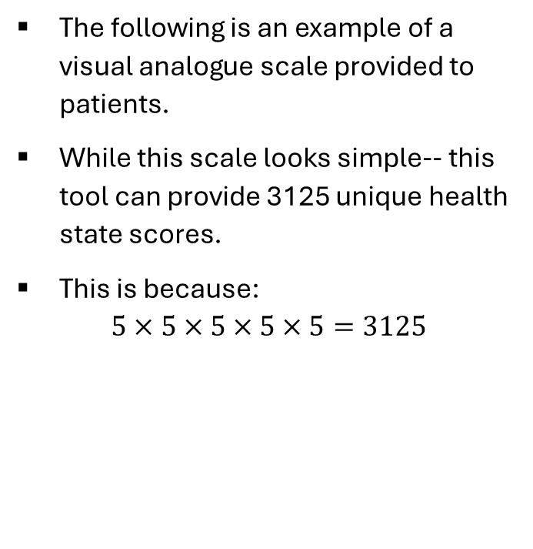
An Example of a VAS: the EQ-5D-5L
The following is an example of a visual analogue scale provided to patients.
While this scale looks simple-- this tool can provide 3125 unique health state scores.
This is because:
$5×5×5×5×5=3125$

Slide 43
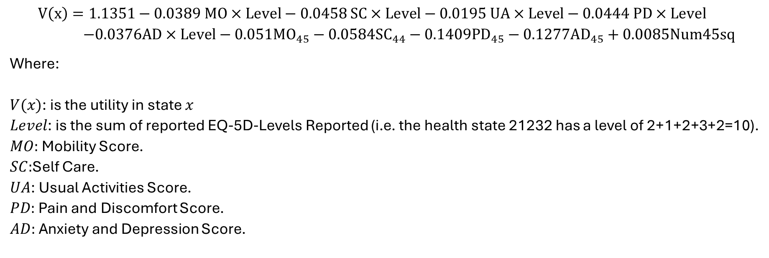
The EQ-5D-5L Value Set for Canada
$$V\left(x\right)=1.1351−0.0389 MO×Level−0.0458 SC×Level−0.0195 UA×Level−0.0444 PD×Level \\ −0.0376AD×Level−0.051MO_{45}−0.0584SC_{44}−0.1409PD_{45}−0.1277AD_{45}+0.0085Num45sq$$
Where:
$V(x)$: is the utility in state $x$
$Level$: is the sum of reported EQ-5D-Levels Reported (i.e. the health state 21232 has a level of 2+1+2+3+2=10).
$MO:$ Mobility Score.
$SC:$Self Care.
$UA$: Usual Activities Score.
$PD:$ Pain and Discomfort Score.
$AD:$ Anxiety and Depression Score.

Slide 44
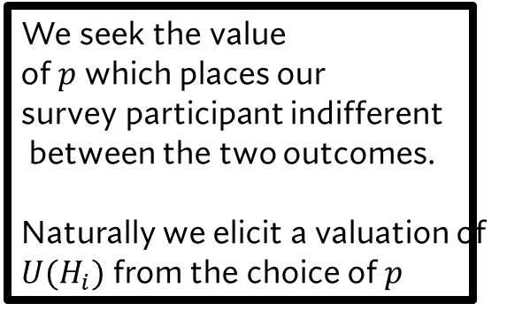






Standard Gamble
Perfect Health
$$p$$
$$U\left(\overline{H}\right)=1$$
We seek the value
of $p$ which places our
survey participant indifferent
between the two outcomes.
Naturally we elicit a valuation of
$U(H_{i})$ from the choice of $p$
$$1−p$$
Death
$$U\left(\underline{H}\right)=0$$
Health State $i$
$$U(H_{i})$$

Slide 45

Standard Gamble Algebraically
$U\left(H_{i}\right)=pU\left(\overline{H}\right)+\left(1−p\right)U\left(\underline{H}\right)$
We know:
$U\left(\overline{H}\right)=1$
$U\left(\underline{H}\right)=0$
This gives us:
$U\left(H_{i}\right)=p$

Slide 46

Standard Gamble Algebraically: Back Pain Example
$U\left(H_{i}\right)=pU\left(\overline{H}\right)+\left(1−p\right)U\left(\underline{H}\right)$
We know:
$U\left(\overline{H}\right)=1$
$U\left(H_{BP}\right)=0.7$
This gives us:
$U\left(H_{i}\right)=p+\left(1−p\right)0.7$
$U\left(H_{i}\right)=p+0.7−p0.7$
$U\left(H_{i}\right)=0.3p+0.7$

Slide 47
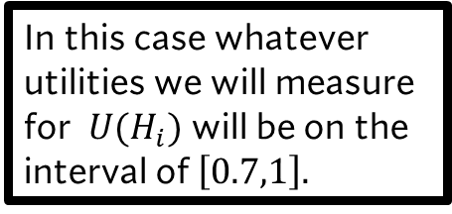

Standard Gamble: without death
Perfect Health
$$p$$
$$U\left(\overline{H}\right)=1$$
In this case whatever utilities we will measure for $U(H_{i})$ will be on the interval of $\left[0.7,1\right].$
$$1−p$$
Life with Back Pain
$$U\left(\tilde{H}\right)=0.7$$
Health State $i$
$$U(H_{i})$$

Slide 48
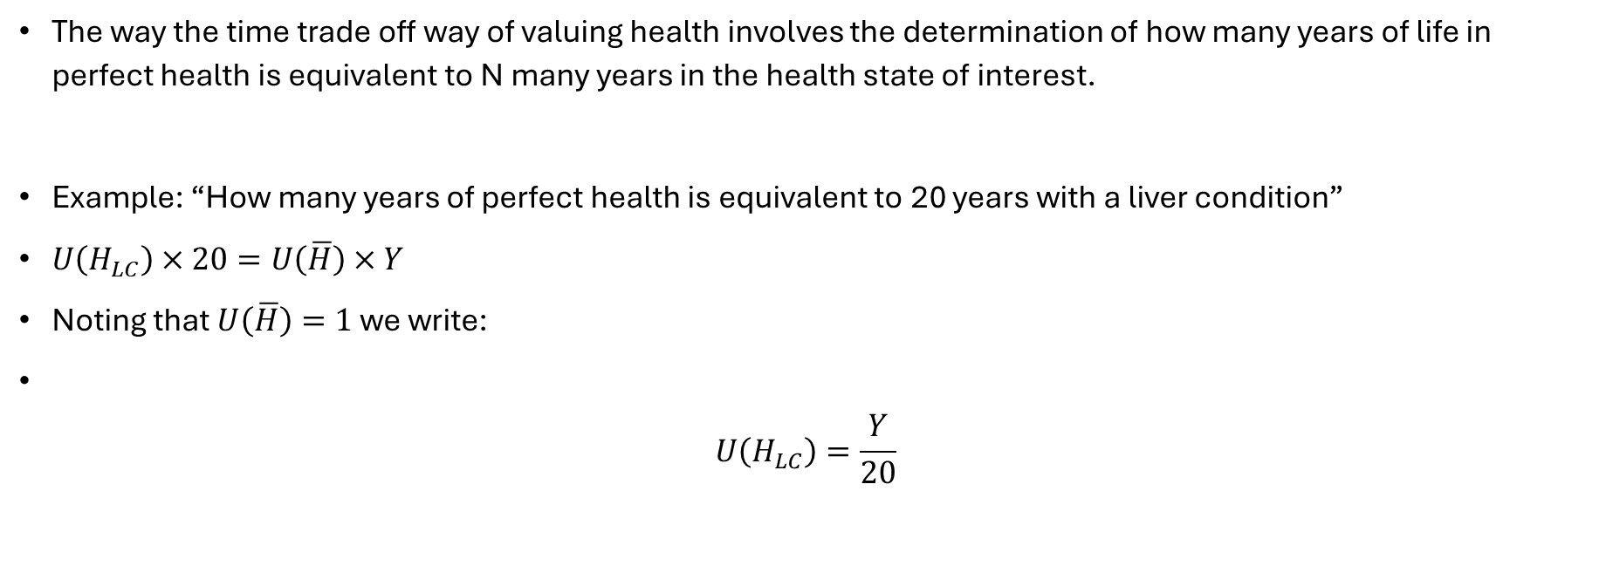
Time Trade Off
The way the time trade off way of valuing health involves the determination of how many years of life in perfect health is equivalent to N many years in the health state of interest.
Example: “How many years of perfect health is equivalent to 20 years with a liver condition”
$U\left(H_{LC}\right)×20=U\left(\overline{H}\right)×Y$
Noting that $U\left(\overline{H}\right)=1$ we write:
$U\left(H_{LC}\right)=\frac{Y}{20}$

Slide 49
Databases for Utilities

Slide 50
Databases for Utilities
Two of the most accessible databases for finding information on utilities. These are:
  The CEA Registry from the Tufts Center for Evaluation of Risk in Health.
  The PEDE Database from SickKids Hospital (specific to pediatrics interventions).
While it's possible to search the literature directly, these sources make accessing data on utilities easier.
In the case of the model free analysis suppose we are interested in the risk of encountering a particular health state?

Slide 51
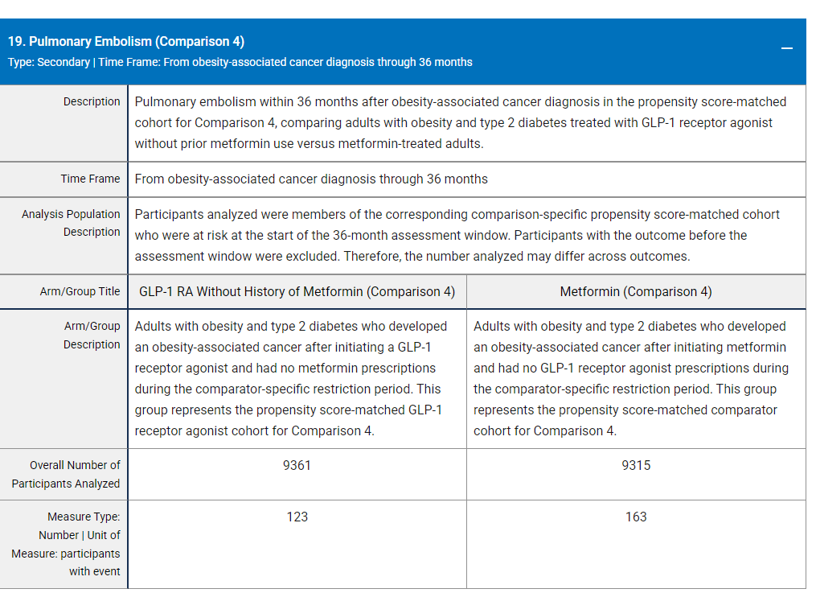
The Model Free Analysis
Consider this secondary outcome from
our clinical trial

Slide 52
The Model Free Analysis
This is the health state of interest.
(We are ignoring these for now because we are ignoring the structure of the clinical
pathway).

Slide 53
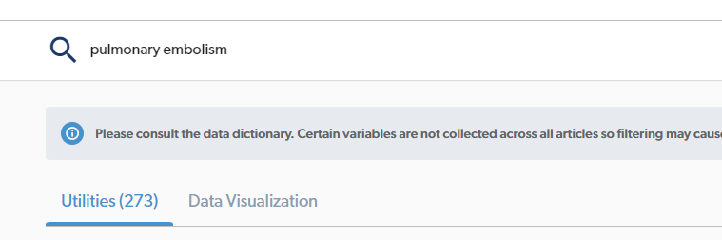
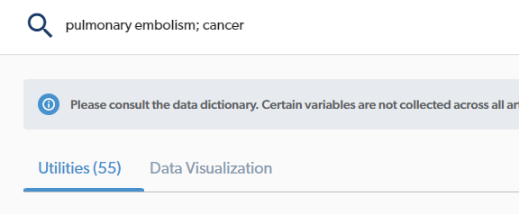
Refining Search Results
The more general your search the more
utilities we will get.
However, you need to be careful as
Some search results may not be fruitful.

Slide 54
Final Remarks about Searching for Inputs
In absence of physician-level data for the exact medical intervention, we will always be working with estimates.
Our job is to provide good ones.
In fact, this is a line of attack for critiquing an article (i.e. are the inputs employed accurate? How are the baseline utilities calibrated?)
If you are using a secondary data source be sure to cite it.
NEXT CLASS WE WILL DISCUSS HOW TO BUILD MODELS
(STARTING WITH DECISION TREES)

